Slide 1
Raw MS Data
Peak selection
Preliminary data
Usually in a simpler version – csv, txt
Advanced Analysis
Trend/prediction
Alignment between different batches
Blank subtraction/ noise removal
End-member
Cluster/classification
Matrix effect
MS2 data process
Something could treat with the ‘data science’ way
Basic structure

Slide 2
Work goal
Scale for the goals
R: refine current workflows
DA: develop/adapt workflows
C: create completely new workflow
Priority for the goals
H: high, the core goal for whole project
M: medium, necessary but less than the highest one if don’t have time
L: Low, stretch goal if only time permits

Slide 3
Our task-Raw MS Data
Peak selection – R, M – mzml files
Identify peaks
Select peaks with ‘good shape’
Deal with peaks with ‘bad shape’
Ref:
https://bitbucket.org/lucashnegri/peakutils/src
https://github.com/Arseha/peakonly
Alignment – DA, H – txt files
First step for the subsequent workflows
Brainstorm for the algorithm – two ways:
Base on graph
Base on data
Alignment for samples from different batchs
Handy platform – DA, L
Interface for users to check ms spectrum/chromatogram
Ref: https://www.youtube.com/watch?v=smjMO9Pl_IU from 7:28

Slide 4
Our task – Data analysis – output from alignment
End member – C, H
Which features stand out from the series of samples?
Cluster/classification – C, H
End-member oriented, train/test samples required
Matrix effect – DA, M
Prediction and modeling effort

Slide 5
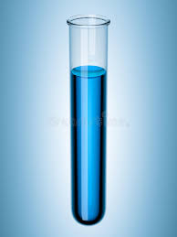
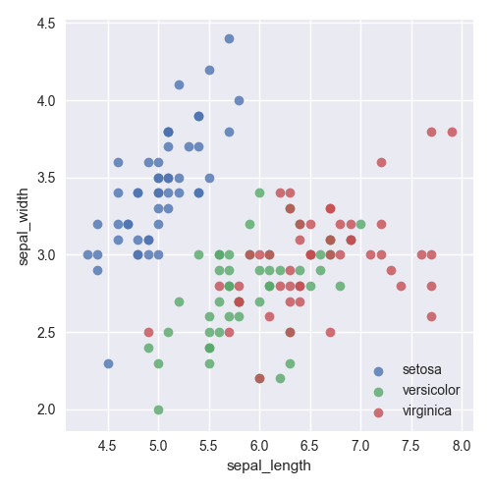
Type A
X n
Batch of similar samples
Should be acquired from same site or same experiment
The cluster could be defined by either
Nearest neighbors
Chemical property (ID needed, or apply machine learning with certain inputs)
Then we can assign all chemicals with cluster label as cpd1 ->cluster1 or etc.
The clusters should have similar behaviors as a entity even if the shift on RT or m/z happens
Thus we can use the sample also from this batch but not used to train the cluster to verify if our cluster algorithm works. Also can apply as a prediction/confirmation method
m/z
Similar scatter plots with slightly change of m/z or RT, also presence of noises
Noise
Cluster1
Cluster2
cluster3
RT
Notes:
Cpd1:pead area[10,9,8,5,3,1,0,0,0,
Cpd2:[5,4.5,4,….]
Cpd3:[10,10,10,10,10,10,10,]

Slide 6
Type B
Simple sample, e.g. sample of 1 tire
Fusion sample, e.g. mixture of 100 tire chemicals
Similar to type A but the cluster in fusion sample is decided by the cluster from simple samples, basically to find pattern for single group and then combine them and apply to a complicated sample.
m/z
After ignored noises, we can get a scatter plot with only ‘purified’ cluster specifically from this tire
We should also be able to find the same cluster within the ‘fusion sample’(could be tricky due to matrix effect)
Noise
Cluster1
Cluster2
cluster3
RT

Slide 7
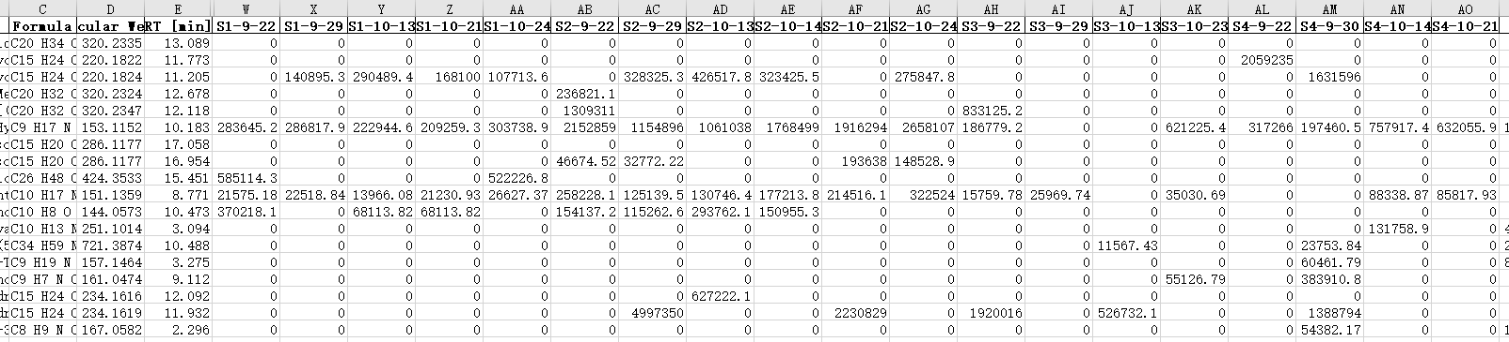
User case
Input: ms data from instrument
Output:
Alignment: summary for all samples input with rt adjusted – either from same batch or different batches

Slide 8
User case
Input: Alignment result
Output:
Clustering: depending on the given samples, select resistant features and group them according to selected criteria(e,g relative position, intensity)
Visualization tool to show the clustering
Type A clustering: Prediction on the dilution rate of a given new sample
Type B clustering: Identification of given source, (strech) calculate the proportion of the given source to the whole mixture

Slide 9
Capstone outcome
Software direction
API release
Data direction
Algorithm/models to solve the cluster issue
Find clusters
Predict dilution
Identify the source presence
Use the cluster information to align samples from different time

Slide 10
Task summary
Fundamental tasks
Peak task – 2people
Peak detection
Peak range decision
Peak integration
Alignment(within batch scale) – 2 people
Peak/Feature alignment
Noise removal
Formatting and exporting
Clustering – brainstorm whole group
Firstly from type A create a feasible method to distinguish clusters
Adapt method on type B
Verify the method

Slide 11
Task summary
Stretch tasks:
Handy interface integrate all functions – 1~2 people
MS2 functions(discuss) – 1~2 people
Auto check for the result quality – 1people

Slide 12
Timeline
Google doc

Slide 13
General tasks for clustering
Identify noises, clean the dataset to remove it
Develop an algorithm to define the clusters according to different types of data
Deal with the possible data loss due to the matrix effect
Verify the cluster model on the similar but new dataset
Predict new sample for the cluster confirmation or etc.(still under thinking)

